Slide 1

Rusterizer Masterclass 03 Going 3D
Luca Quartesan – quartesan.l@buas.nl – 03-10/02/2021

Slide 2
Welcome v0.2
Features that we are not going to implement are marked with 🚩
🚩are left behind so you can expand on what we see during the lectures

Slide 3
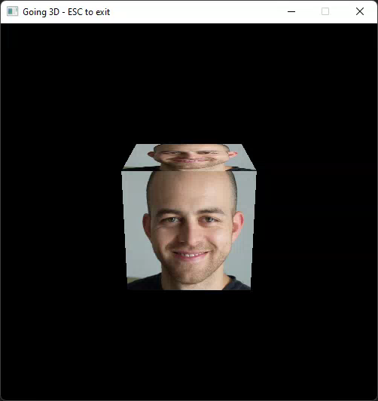
Agenda
Last Episode
3D Transformations
Camera
Viewport Transformations
Rotating Cube

Slide 4
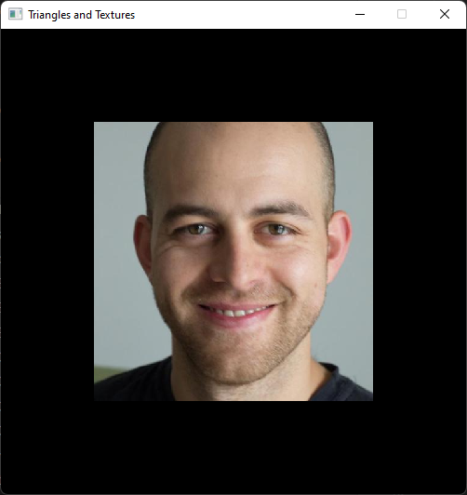
Last Episode
Vertex attributes describe position and other surface parameters
We can map textures to surfaces
When rasterizing a surface we interpolate the vertex attributes
We can do this with barycentric coordinates
Barycentric coordinates ⚖️
how close we are to a vertex
how much that vertex contributes

Slide 5
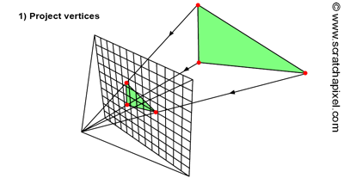
Going 3D
As you have seen we can render already a 3D triangle
So, what are we missing?
As promised, we are going to project 🎥
https://www.scratchapixel.com/lessons/3d-basic-rendering/rasterization-practical-implementation/overview-rasterization-algorithm.html

Slide 6
Transformations
2D/3D transformations done with matrices
Vector * Matrix
Matrix * Matrix

Slide 7
Anatomy of a 3D transform
Translation, Scale: vec3
Rotation: quat
Output: TRS (mat4)
Get orientation/Gizmo (forward, right, up)
Translate, rotate, scale
Parenting 🚩

Slide 8

Matrix * Matrix

Slide 9
Vector * Matrix

Slide 10
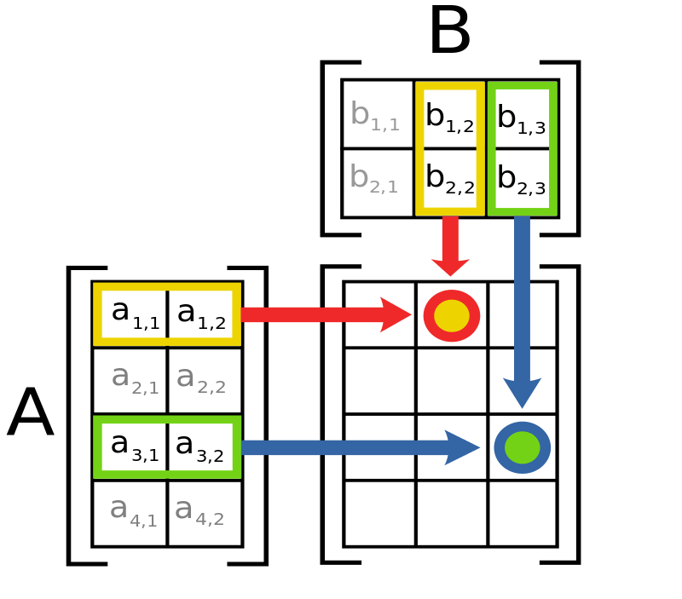
Matrix multiplication

Slide 11
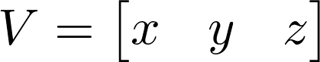
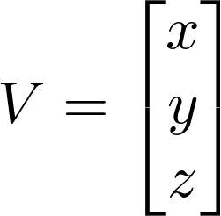
Column vs Row major
Vectors can be expressed as matrices:
Row Major (1,3)➡️
Column Major (3,1) ↘️
One is the Transpose of the other
This choice influences the orders of matrix multiplication

Slide 12
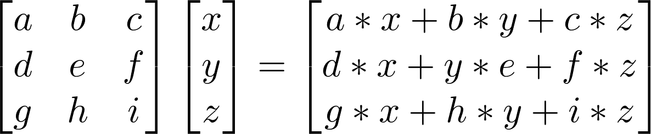
Matrix * Vector (Column Major)
M*V ⬅️
We will stick with column major/vector throughout the lessons

Slide 13
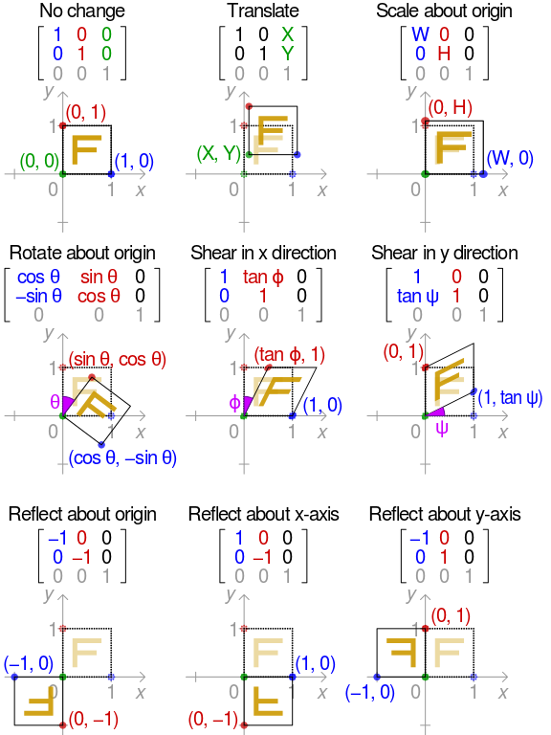
2D Transformations
https://en.wikipedia.org/wiki/Transformation_matrix

Slide 14
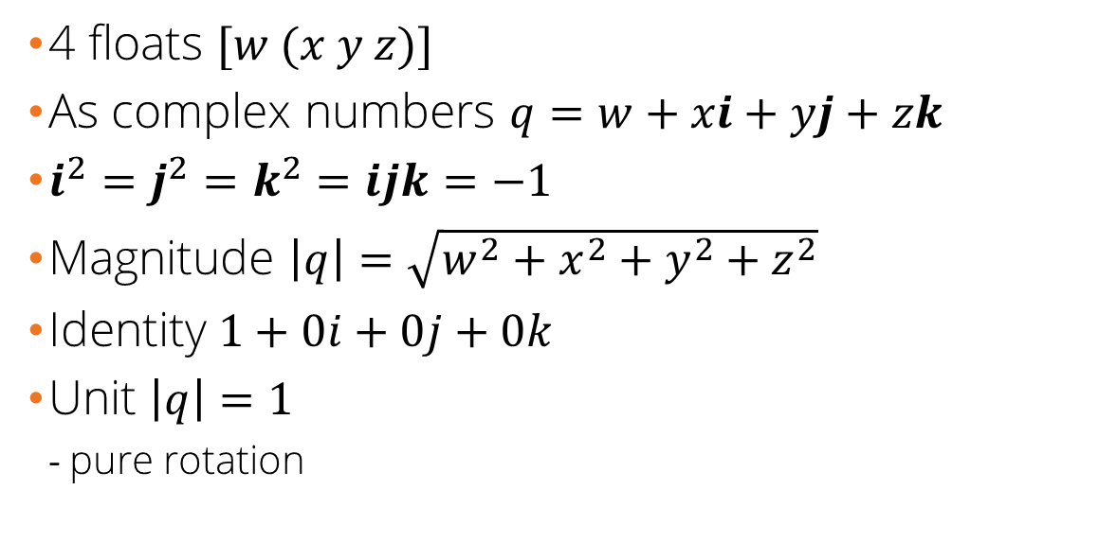
Quaternions
4 floats $[w (x y z)]$
As complex numbers $q=w+xi+yj+zk$
$i^{2}=j^{2}=k^{2}=ijk=−1$
Magnitude $\left|q\right|=\sqrt{w^{2}+x^{2}+y^{2}+z^{2}}$
Identity $1+0i+0j+0k$
Unit $\left|q\right|=1$
pure rotation
https://eater.net/quaternions/
https://glm.g-truc.net/0.9.0/api/a00135.html

Slide 15
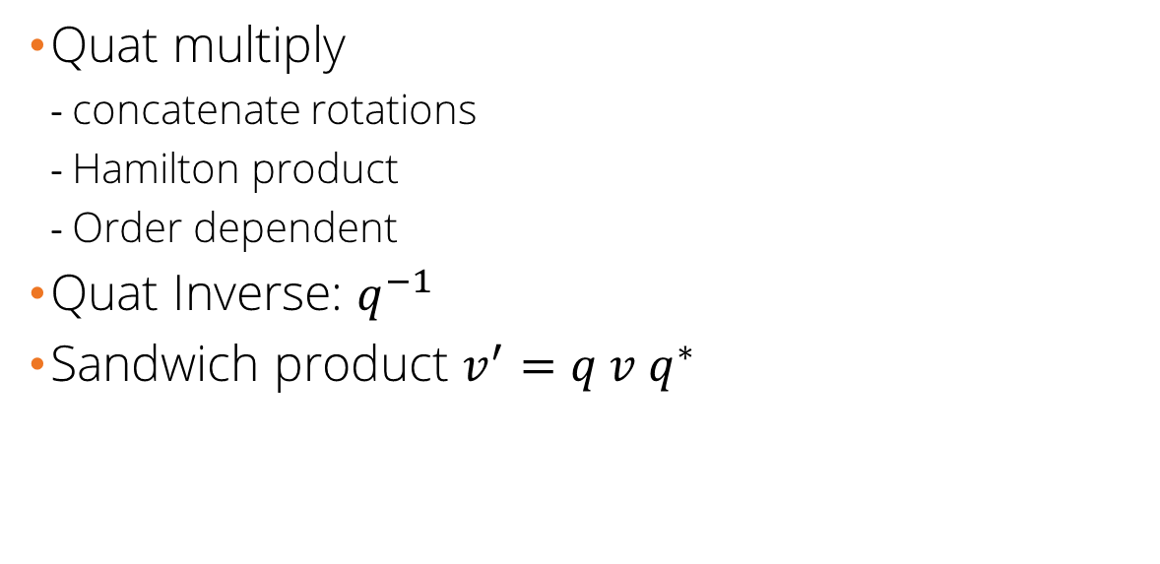
Quaternions
Quat multiply
concatenate rotations
Hamilton product
Order dependent
Quat Inverse: $q^{−1}$
Sandwich product $v^{′}=q v q^{∗}$
https://eater.net/quaternions/
https://glm.g-truc.net/0.9.0/api/a00135.html
Notes:
= $(\cos\left(\frac{θ}{2}\right),\sin\left(\frac{θ}{2}\right)a_{x},\sin\left(\frac{θ}{2}\right)a_{y},\sin\left(\frac{θ}{2}\right)a_{z}$

Slide 16
Concatenate transformations
A.k.a. matrix multiplication
We can concatenate transformations using matrix multiplication
But order matters
Order of transformations
Column vs Row major/vector

Slide 17
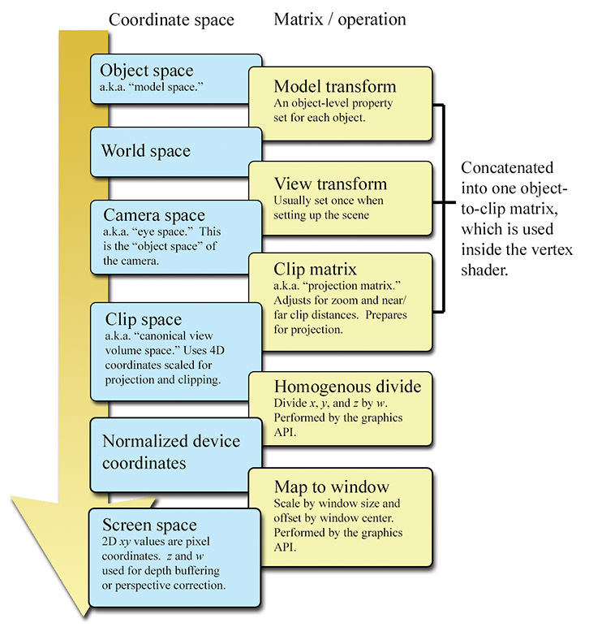
Coordinate Systems/Spaces
During a rasterization pipeline we transform our vertices between different coordinate spaces
Each is accompanied by a matrix
Except for the viewport transformations
https://gamemath.com/book/figs/graphics/coordinate_spaces_summary.png

Slide 18
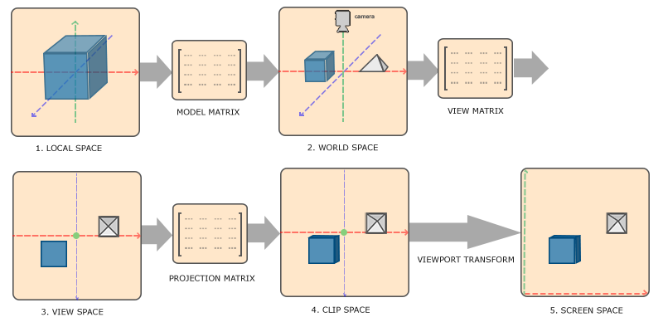
Coordinate Systems
https://learnopengl.com/Getting-started/Coordinate-Systems

Slide 19
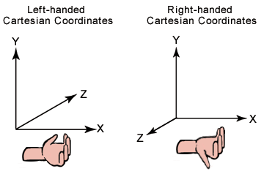
3D Coordinate systems
We are going for RH
https://docs.microsoft.com/en-us/previous-versions/windows/desktop/bb324490(v=vs.85)

Slide 20
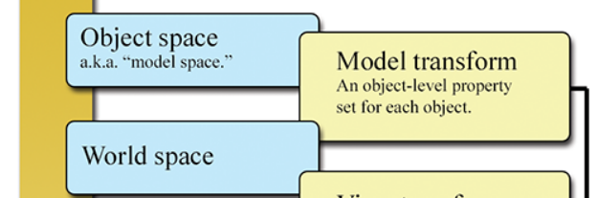

Model Matrix
We transform an object from “local” to “World” space
Consists in 3 matrices:
Scale
Rotation *
Translation
*We store our rotation as quaternion and then convert to matrix in this step

Slide 21
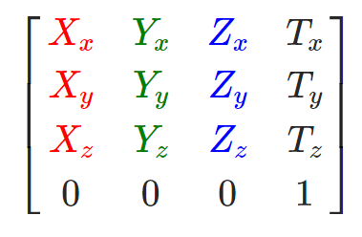
Model Matrix (column)

Slide 22
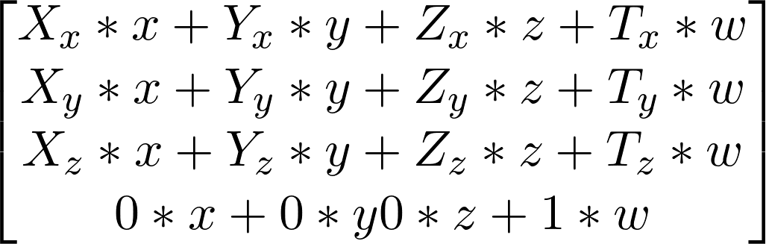
Model Matrix (homogeneous coords)
Homogenous/Projective coordinates
🤔 difference between vectors and points?

Slide 23
Model Matrix (homogeneous coords)
If we are describing a point w=1 👉 Translation
If we are considering a vector w=0 ⛔ Translation

Slide 24
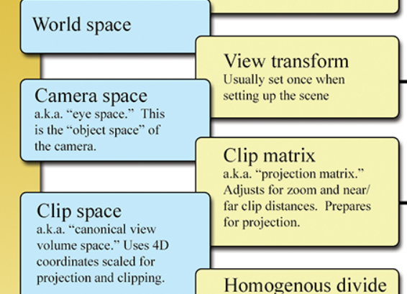
Camera
Consists in 2 operations:
View
Projection/Clip
Done through matrices
Different between RH or LH👈

Slide 25
View Matrix (Beware of RH/LH)
Brings the whole scene from the perspective of a camera:
Camera is at the centre of the “world”
World from camera point of view
Usually calculated using the a LookAt matrix
Position (eye),
Target,
Up Direction

Slide 26
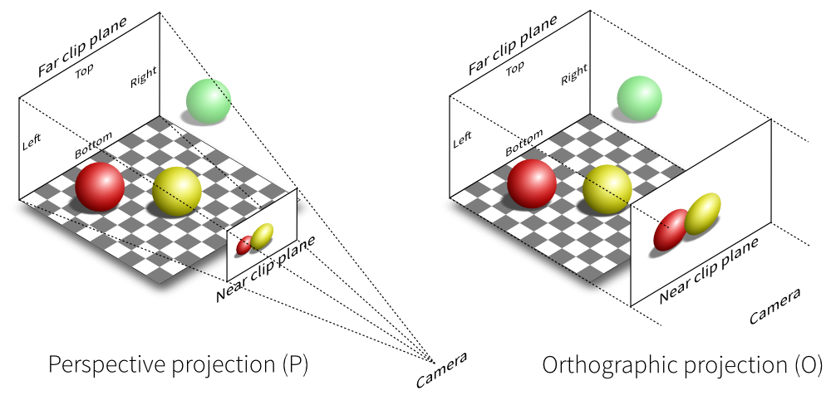
Projection Matrix (Beware of RH/LH)
Either:
Orthographic: parallelepiped
Perspective: Frustum
https://stackoverflow.com/questions/36573283/from-perspective-picture-to-orthographic-picture

Slide 27
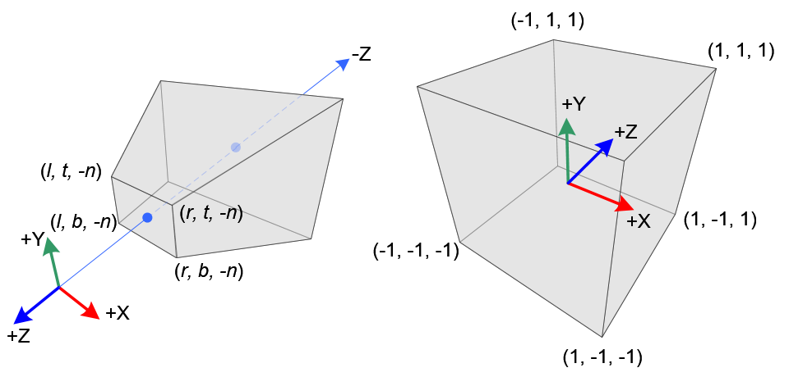
Projection Matrix (Beware of RH/LH)
It maps view volume to a unit cube
https://stackoverflow.com/questions/36573283/from-perspective-picture-to-orthographic-picture

Slide 28
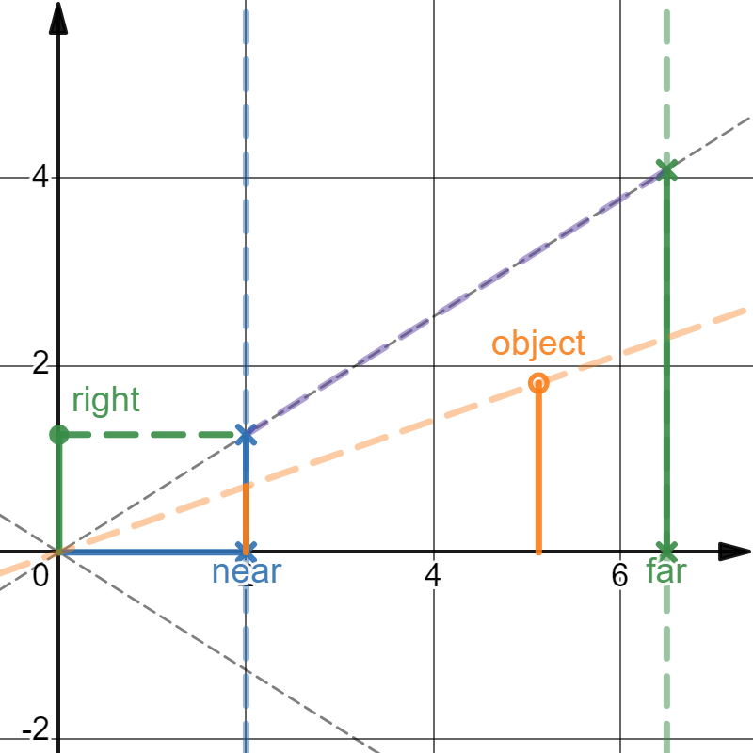
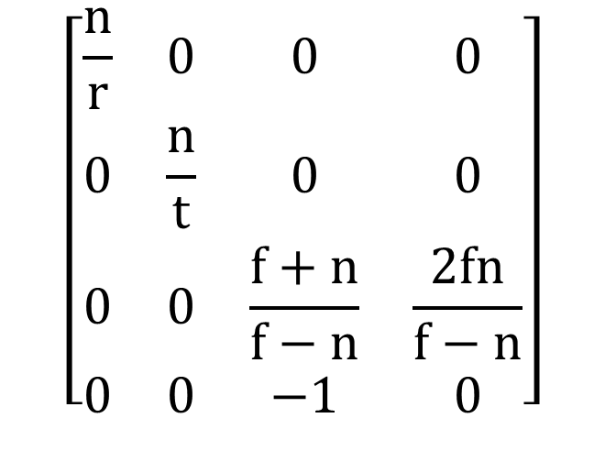
Perspective Projection (GL RH)
Since our viewing frustum is symmetric in x and y
$$\left[\begin{matrix}\frac{n}{r} & 0 & 0 & 0 \\ 0 & \frac{n}{t} & 0 & 0 \\ 0 & 0 & \frac{f+n}{f−n} & \frac{2fn}{f−n} \\ 0 & 0 & −1 & 0\end{matrix}\right]$$
https://www.desmos.com/calculator/3pfg7sn7mp

Slide 29
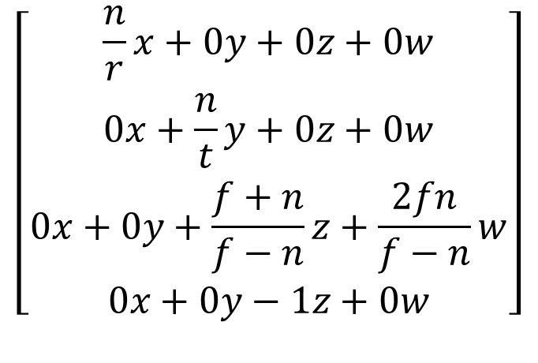
Perspective Projection (GL RH)
$$\left[\begin{matrix}\frac{n}{r}x+0y+0z+0w \\ 0x+\frac{n}{t}y+0z+0w \\ \begin{aligned}0x+0y+\frac{f+n}{f−n}z+\frac{2fn}{f−n}w \\ 0x+0y−1z+0w\end{aligned}\end{matrix}\right]$$
https://www.desmos.com/calculator/3pfg7sn7mp

Slide 30
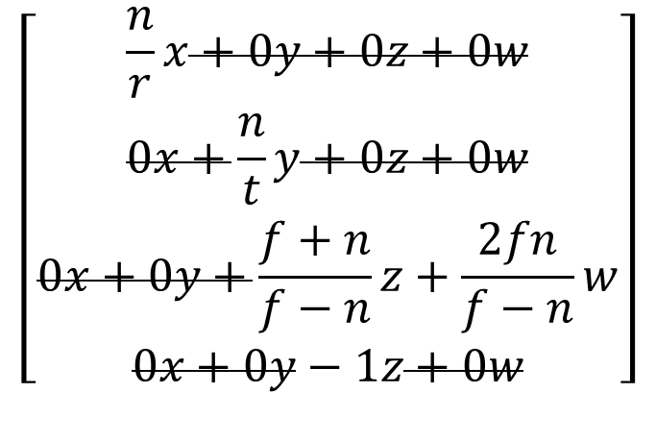
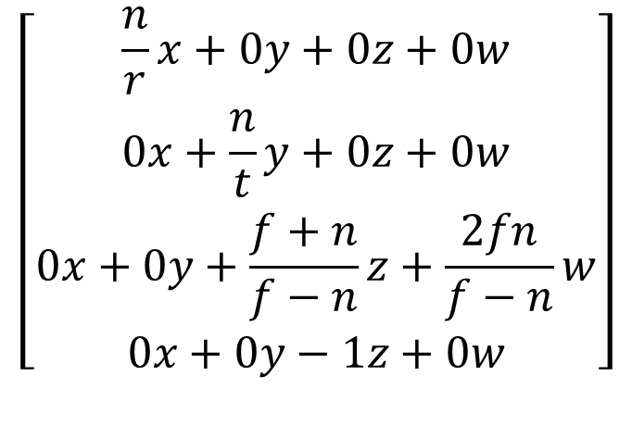
Perspective projection (GL RH)
Let’s multiply our vector by the matrix
$$\left[\begin{matrix}\frac{n}{r}x+0y+0z+0w \\ 0x+\frac{n}{t}y+0z+0w \\ \begin{aligned}0x+0y+\frac{f+n}{f−n}z+\frac{2fn}{f−n}w \\ 0x+0y−1z+0w\end{aligned}\end{matrix}\right]$$
$$\left[\begin{matrix}\frac{n}{r}x+0y+0z+0w \\ 0x+\frac{n}{t}y+0z+0w \\ \begin{aligned}0x+0y+\frac{f+n}{f−n}z+\frac{2fn}{f−n}w \\ 0x+0y−1z+0w\end{aligned}\end{matrix}\right]$$

Slide 31
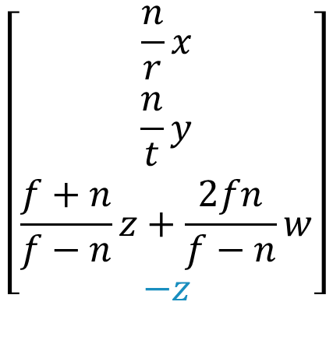
Perspective projection (GL RH)
🥸clip space w = view z (and a – because of rh coordinates system)
$$\left[\begin{matrix}\frac{n}{r}x \\ \frac{n}{t}y \\ \begin{aligned}\frac{f+n}{f−n}z+\frac{2fn}{f−n}w \\ −z\end{aligned}\end{matrix}\right]$$

Slide 32
Small note
https://docs.rs/glam/0.24.2/src/glam/f32/sse2/mat4.rs.html#811
It’s slightly different
But…

Slide 33
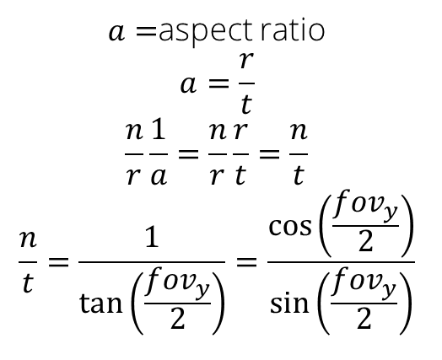
Perspective Projection
As a function of the angle
$$\left[\begin{matrix}\frac{n}{r} & 0 & 0 & 0 \\ 0 & \frac{n}{t} & 0 & 0 \\ 0 & 0 & \frac{f+n}{f−n} & \frac{2fn}{f−n} \\ 0 & 0 & −1 & 0\end{matrix}\right]$$
$a=$aspect ratio
$$a=\frac{r}{t}$$
$$\frac{n}{r}\frac{1}{a}=\frac{n}{r}\frac{r}{t}=\frac{n}{t}$$
$$\frac{n}{t}=\frac{1}{\tan\left(\frac{fov_{y}}{2}\right)}=\frac{\cos\left(\frac{fov_{y}}{2}\right)}{\sin\left(\frac{fov_{y}}{2}\right)}$$
https://www.desmos.com/calculator/u6gaftslle

Slide 34

Putting it all together MVP
We can concatenate these 3 operations in a single matrix:

Slide 35
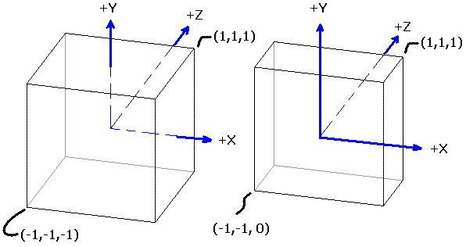
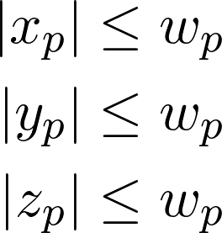
Clip space
Projection matrix
clip coordinate system is a homogeneous coordinate system
the name comes from the fact that we do triangle clipping in this space.. more on that the next episode
Projects the frustum into a volume

Slide 36
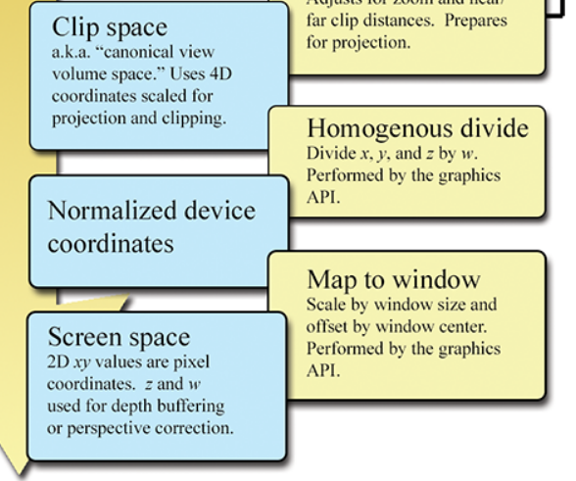
Viewport Transformations
Perspective/homogenous divide
Map to viewport/window

Slide 37
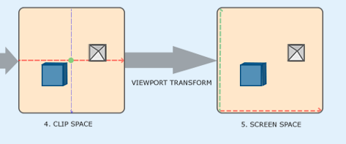
Perspective Divide
Normalizes Clip space by dividing for w (= z in view space)
W normalizes this values based on the view frustum
Resulting in Normalized device coordinates (NDC)
Also called perspective/homogenous divide

Slide 38
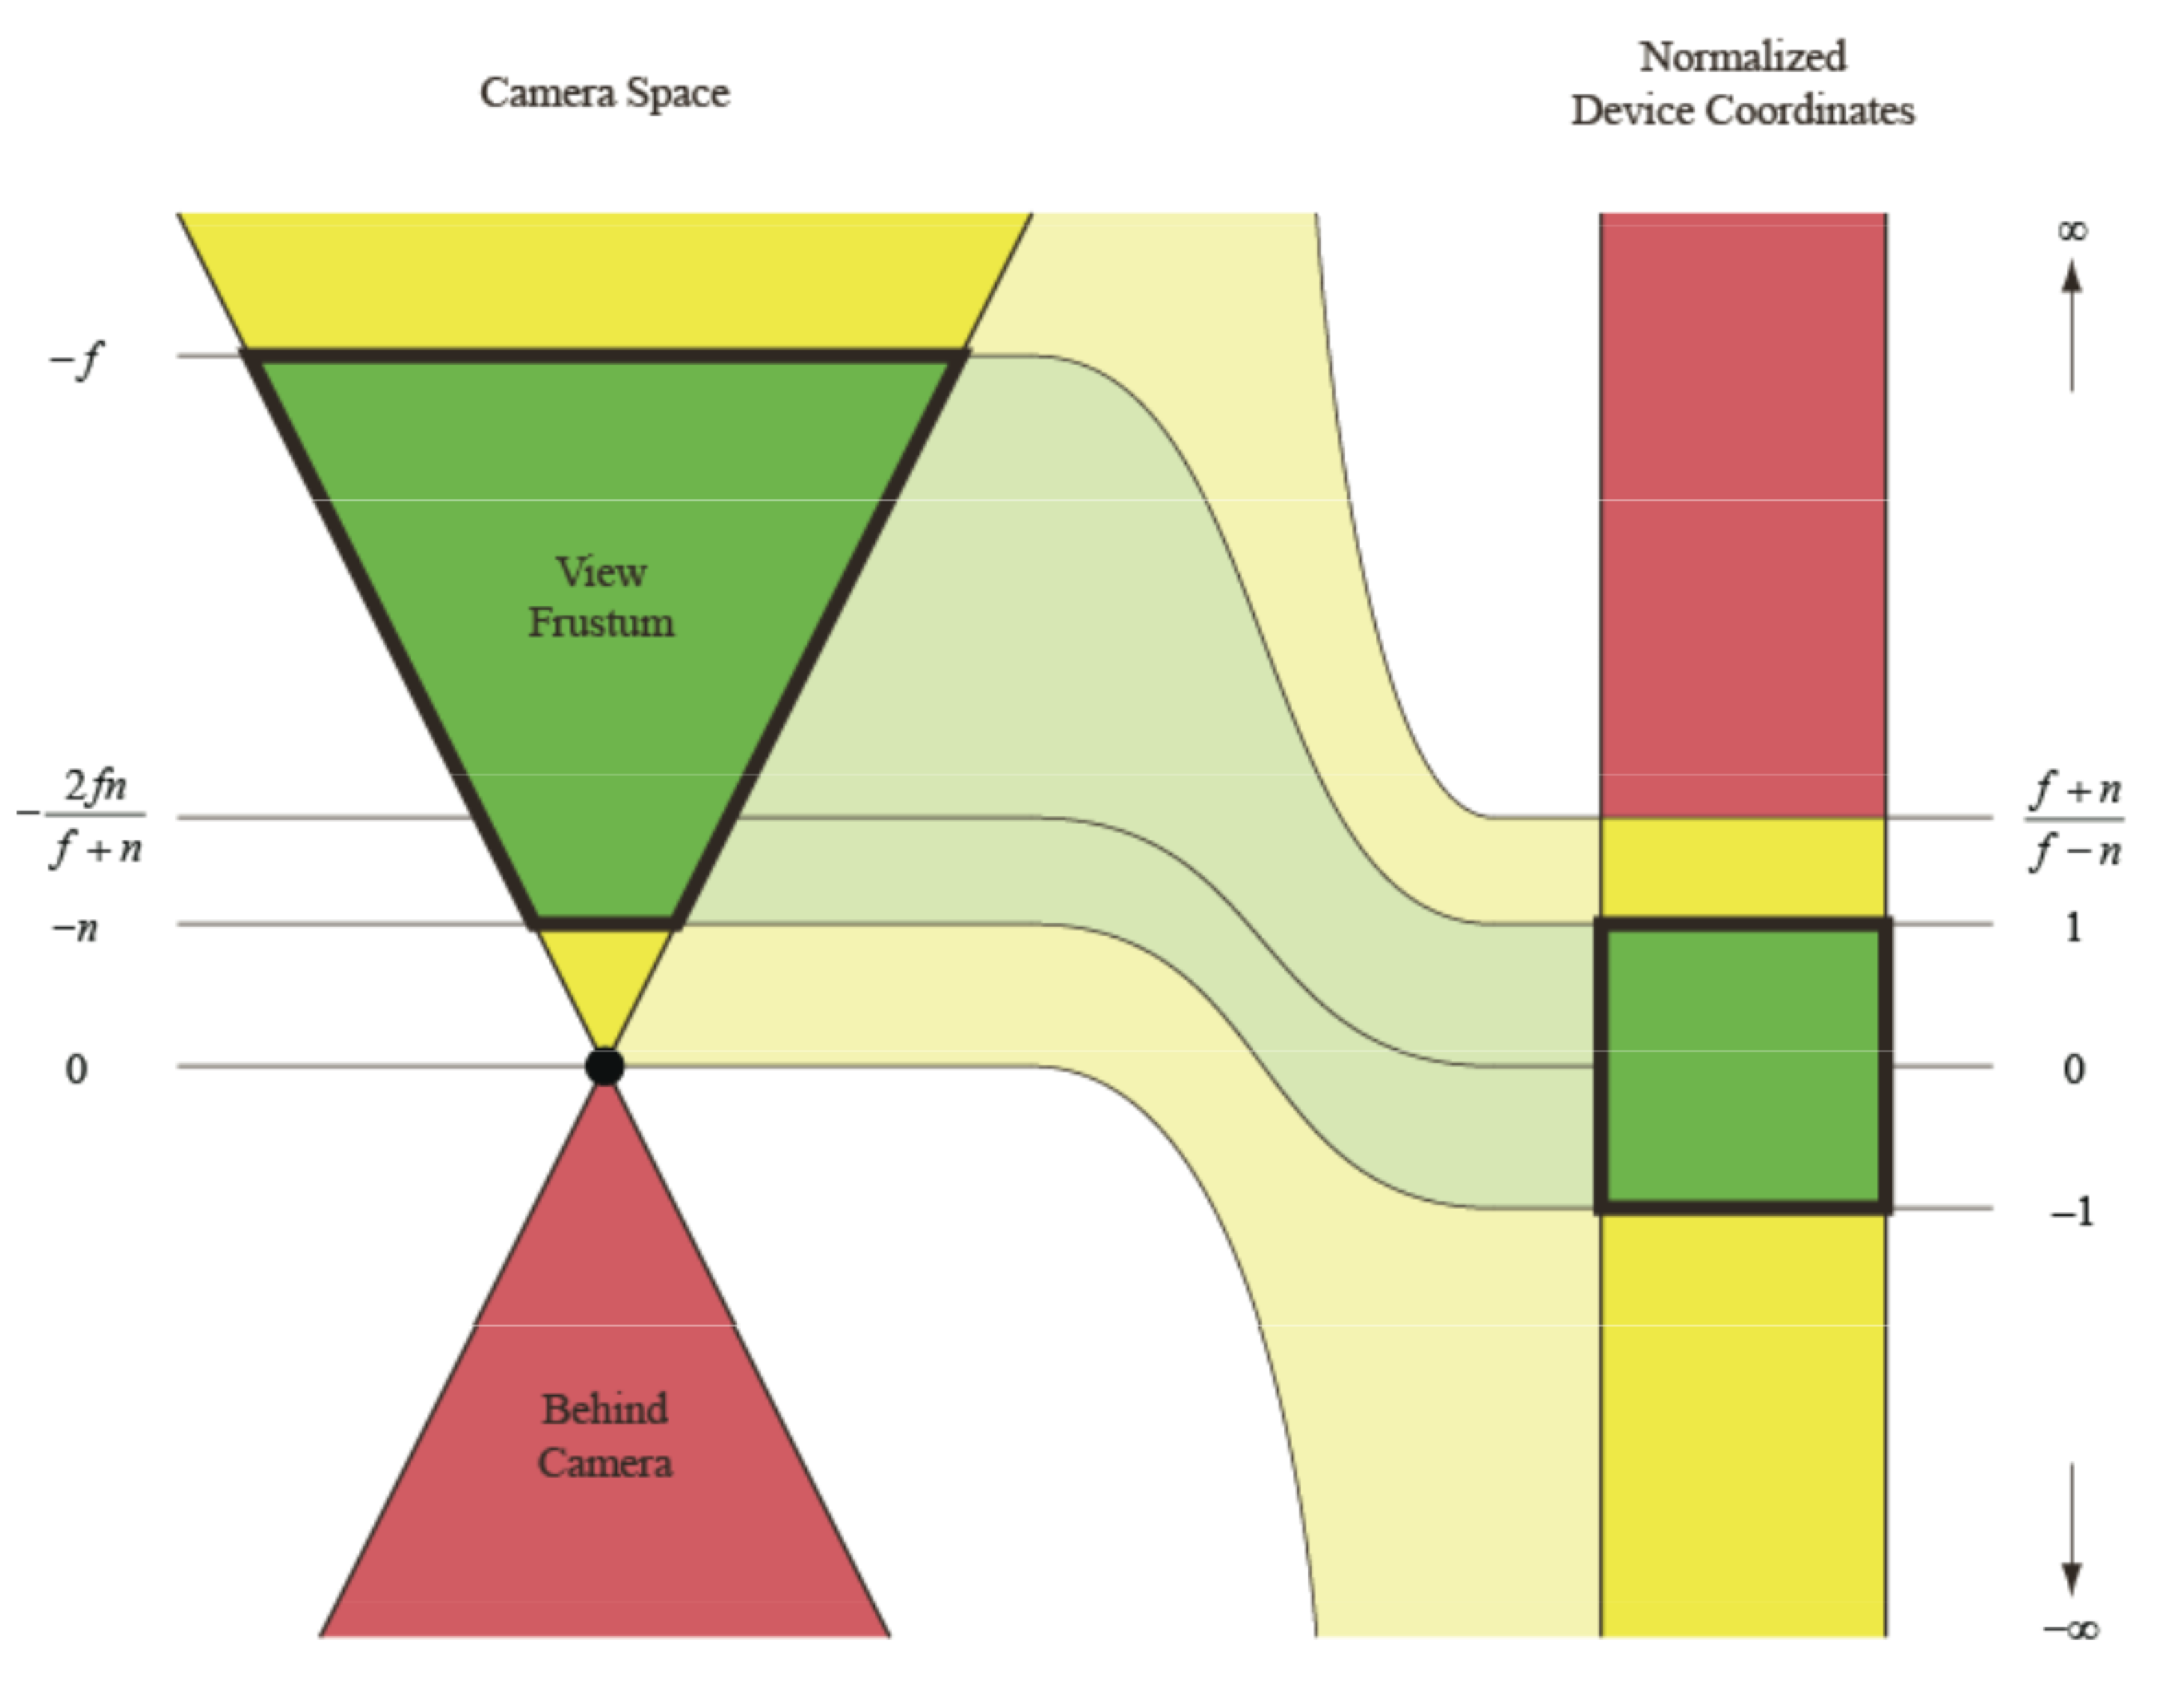
Camera => NDC
https://twitter.com/EricLengyel

Slide 39
Map to viewport
Simply maps from [-1, 1] to viewport size
Remember that the y on the window is inverted!

Slide 40
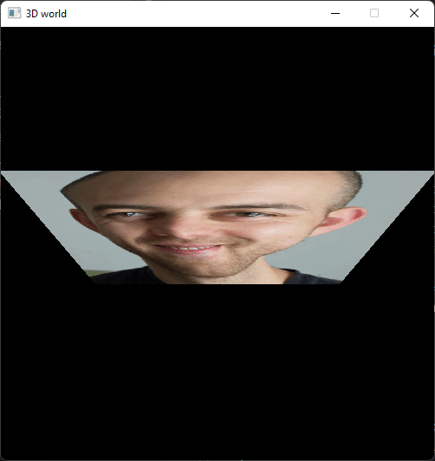
Rotating quad
What is going on?

Slide 41
Perspective correction
Affine mapping:
Does not take depth into account
Perspective correct mapping:
Take depth into account

Slide 42
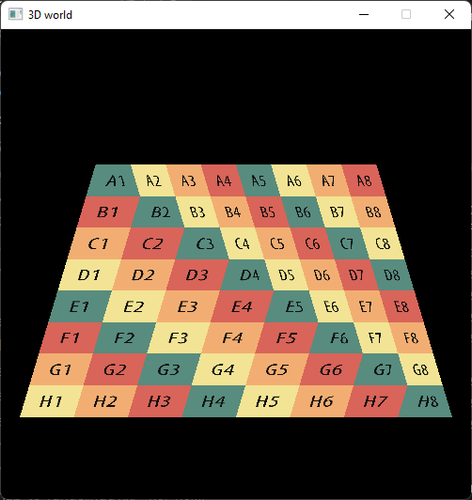
Affine Mapping
the problem is that we are interpolating the texture values in screen space instead of 3D, therefore discarding depth information

Slide 43
Perspective correction
When we interpolate our parameter
we divide-first-then-interpolate➡️, since we are past NDC (we divided by w)
projection ➡️ Interpolation
what would have been the parameter β if we had interpolate-first-then-divide ⬅️
Interpolation ➡️ projection
We want to interpolate in 3D

Slide 44
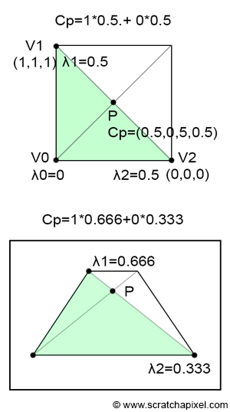
Perspective correction
We need to take also the difference in depth (z)
We can use view z (🥸)
https://www.scratchapixel.com/lessons/3d-basic-rendering/rasterization-practical-implementation/perspective-correct-interpolation-vertex-attributes

Slide 45
Perspective correction
Divide attributes by their z (reciprocals)
Then interpolate the attributes and z
Multiply attribute by interpolated z

Slide 46
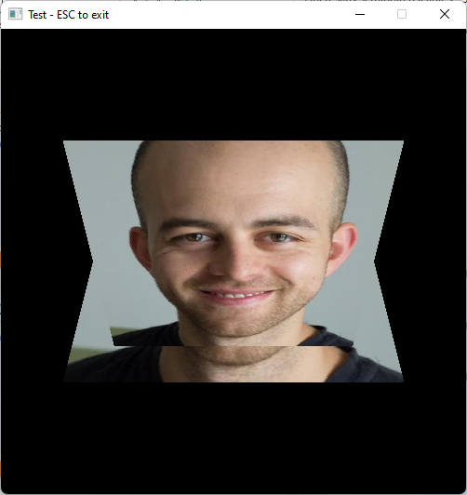
Adjusting the depth buffer
Also the depth requires “perspective correction”

Slide 47
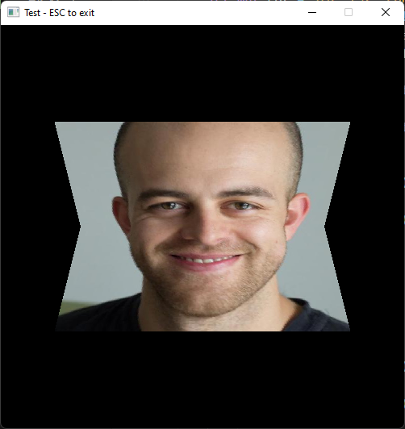
Adjusting the depth buffer

Slide 48
Rotating Cube
Concatenating “model” matrices to parent objects together
Let’s have a parent transform a 6 children to make a cube from our quad

Slide 49
Rotating Cube

Slide 50
Thank you! 🦀
Many questions?

Slide 51
You could try
Scene Graph-ish / parenting
Loading a model (we will see how to load a Gltf next eppi)
Moving camera

Slide 52
Resources
Rasterization: a Practical Implementation
Optimizing Software Occlusion Culling – index | The ryg blog
Texture Mapping & Polygon Rasterizing Tutorial (1/2) [C++20] – YouTube
3D Programming Fundamentals [Introduction] Tutorial 0 – YouTube

Slide 53
Resources
Rasterizer Algorithm Explanation – YouTube
https://paroj.github.io/gltut/Texturing/Tut14%20Interpolation%20Redux.html
http://www.songho.ca/opengl/gl_projectionmatrix.html

Slide 54
Resources – 3D Math Primer
Introduction to Matrices - 3D Math Primer for Graphics and Game Development
Matrices and Linear Transformations - 3D Math Primer for Graphics and Game Development
More on Matrices - 3D Math Primer for Graphics and Game Development

Slide 55
Resources – 3Blue1Brown
Linear transformations and matrices | Chapter 3, Essence of linear algebra – YouTube
Matrix multiplication as composition | Chapter 4, Essence of linear algebra – YouTube
Three-dimensional linear transformations | Chapter 5, Essence of linear algebra – YouTube
Quaternions and 3d rotation, explained interactively - YouTube

Slide 56
Resources
The Perspective and Orthographic Projection Matrix (scratchapixel.com)

